Slide 1


Media Analysis
Presenting By :
Group 1

Slide 2
GROUP MEMBERS :
Raj Kumar Swarna
Narsipuram Nagendra babu
Arpan Ashok Divekar
Yuddandi Sravani
Leela Nagaraj
Salvadi Lakshmi Prasanna
Pavan

Slide 3
Media Analysis Overview
Purpose:
Analyze Facebook Ads and linked post performance to guide media strategy.
Data Sources:
Facebook Ads data (.xlsx)
Linked Posts data (.xlsx)
Tools Used:
Excel
Tableau
PowerBI
SQL
Focus Areas:
Ad performance
Engagement trends
Content effectiveness

Slide 4
Introduction to FACEBOOK ADS ANALYSIS
The FB-Ads Dashboard — a comprehensive data visualization project designed to track, analyze, and to know the Ads effect on the social media.
In this project, we have used Excel, Tableau, and Power BI to build insightful dashboards that showcase key metrics such as:
Total Ads & Revenue
Return on Add Spent (ROAS)
Cost Per Lead (CPL)
User Ratings & Feedback
Top-performing Ads with more likes and comments
These dashboards help in making data-driven decisions by providing a clear view of real-time performance through KPIs, charts, and interactive visuals.

Slide 5
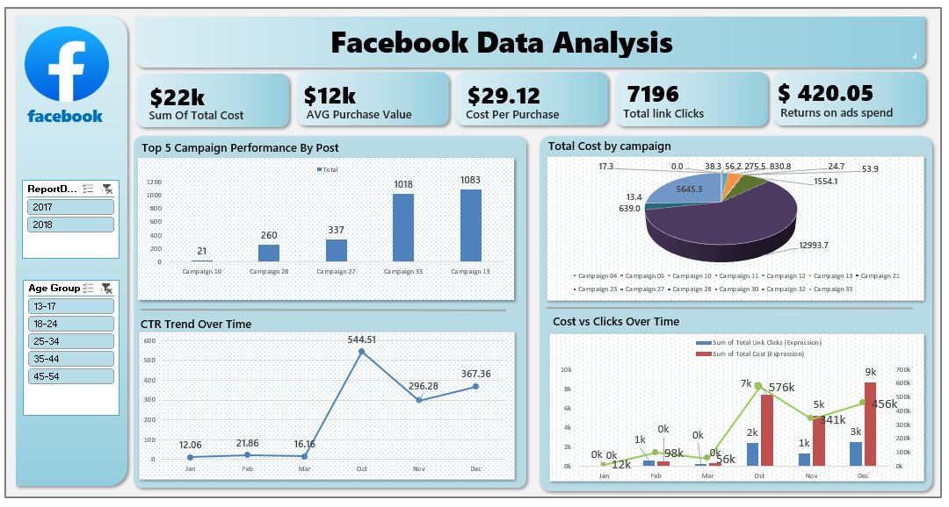

Slide 6
Facebook Ads Performance Analysis: Project Overview & Data Journey
1. Project Overview
To analyze Facebook ad campaign performance to identify key trends, optimize ad spend, and enhance return on investment (ROI). This dashboard provides a comprehensive view of critical metrics for informed decision-making.
2. Data Collection
Facebook.xlsx file is taken and started finding the key insights from the excel file.
Power Query was utilized to structure and shape the data, preparing it for analysis. This involved selecting relevant columns and ensuring data types were appropriate for calculation.
3. Data Preparation
No manual data cleaning steps were performed outside of the initial Power Query import and structuring.
Following the Power Query process, the prepared data was loaded to create pivot tables.
These pivot tables formed the foundation for generating the various charts and calculating the Key Performance Indicators (KPIs) displayed on the dashboard.

Slide 7
4. Dashboard Creation & KPIs.
Dashboard creation involves transforming prepared data (via Power Query and Pivot Tables in Excel) into an interactive visual display. It centralizes key performance indicators (KPIs) and trends, enabling quick understanding and data-driven decision-making.
Some Key Performance Indicators (KPIs) like
Sum of Total Cost ($22k): Overall ad expenditure.
Average Purchase Value ($12k): Average revenue per purchase.
Cost Per Purchase ($29.12): Cost to acquire one purchase.
Total Link Clicks (7196): User engagement with ads.
Returns on Ads Spend ($420.05): Revenue generated per dollar spent.
Key Insights
Campaigns 33 & 31 show strong performance, indicating effective content or targeting.
Remarkable CTR spike in October (544.51) highlights successful ad creative/targeting during that period.
Opportunities exist to optimize ad spend for better click efficiency, especially where costs were high relative to clicks.
Continuous focus on Cost Per Purchase and Returns on Ad Spend is crucial for maximizing profitability.
5. Conclusion
Comprehensive Performance Overview: The dashboard offers a complete and visual summary of how ad campaigns are performing.
Data-Driven Optimization: It facilitates insights derived from data, allowing for efficient allocation of ad spending.
Strategy Identification & Improvement: The tool helps in pinpointing successful advertising approaches and ultimately enhancing campaign outcomes.

Slide 8
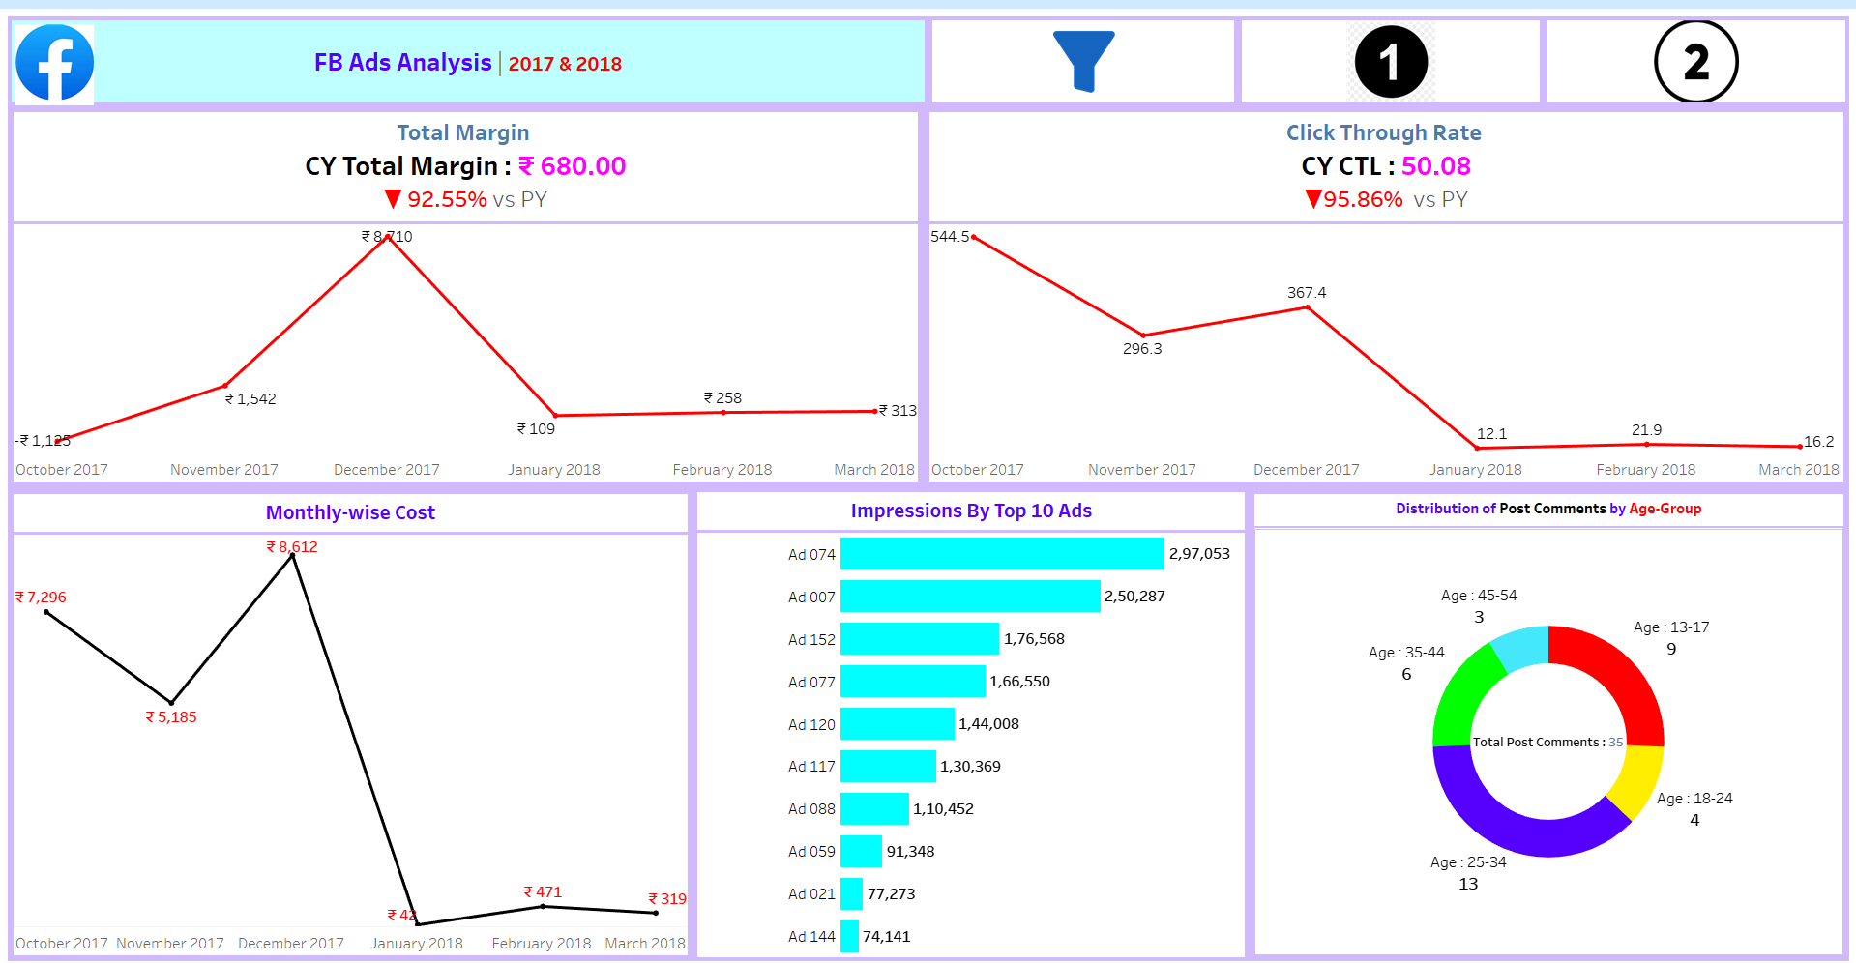

Slide 9
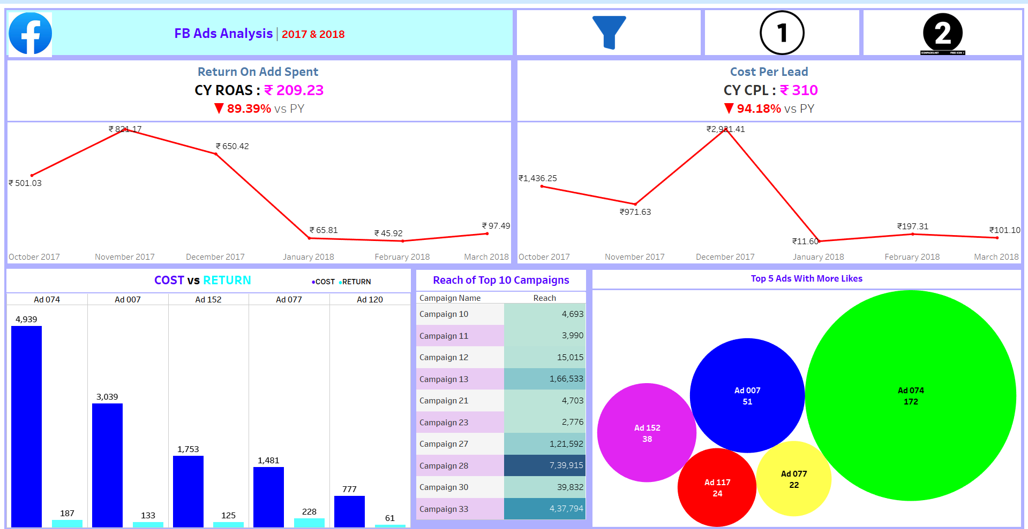

Slide 10
Tableau – FB-ADS ANALYSIS Dashboard Insights and Key Findings
1. Big Problems
Revenue Crash: ROAS dropped 89% (₹209 vs. PY), margins fell 93% (₹680 total).
Wasteful Spending: Some ads (e.g., Ad 074) cost ₹4,939 but earned only ₹187.
Low Engagement: CTR collapsed 96% (50.08 vs. PY).
2. What Worked
Top Campaigns: Campaign 28 (7.9L reach), Campaign 33 (4.98L reach).
Best Ads: Ad 077 (good returns + likes), USD/JPY ads (high ROAS).
Engaged Audience: Age 45-54 (but small volume).
3. Quick Fixes
Stop wasting money on low-return ads (e.g., Ad 074).
Boost top performers like Ad 077 and Campaign 28.
Test new creatives for younger audiences (25-34).
Fix delivery issues (only 34% on-time orders hurt trust).

Slide 11
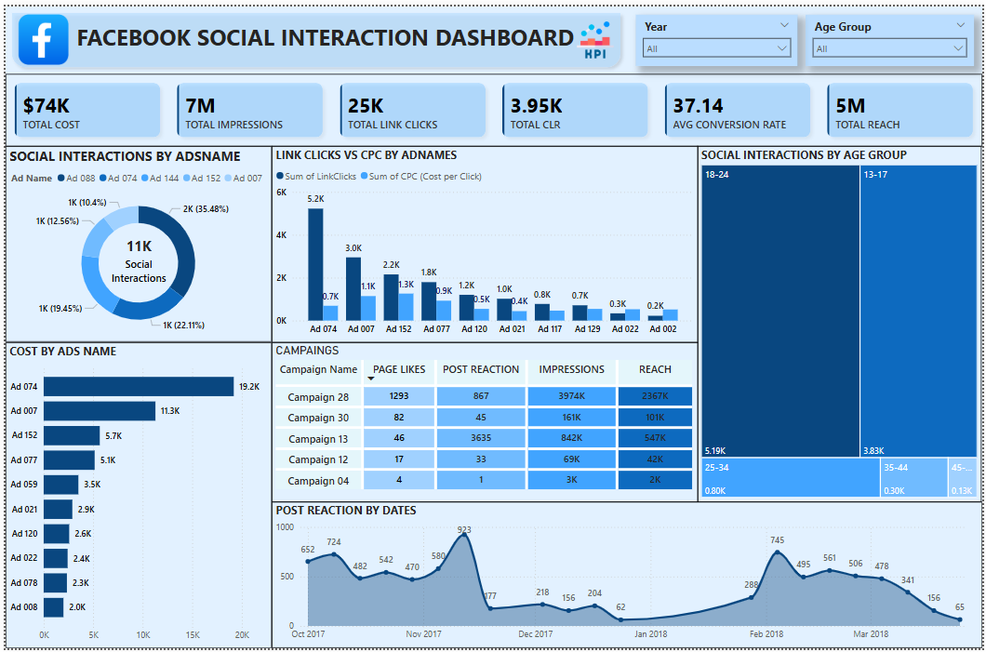

Slide 12
POWERBI-Dashboard main Insights Summary
Total Cost: $74,000
This represents the total budget spent across all active Facebook campaigns during the reporting period. Understanding this baseline is crucial for ROI calculations.
Total Impressions: 7 Million (7M)
A significant volume of ad displays, indicating broad visibility for our campaigns. This metric is foundational for calculating reach and frequency.
Total Link Clicks: 25,000 (25K)
The direct engagement with our ads leading to website visits or specific landing pages. This is a critical indicator of ad effectiveness in driving traffic.
Total CLR (Click-Through Rate): 3.95% (Interpreted as 3.95K in dashboard likely implies 3.95% if based on 25K clicks / 7M impressions * 100)
Assuming this is a percentage (e.g., 25,000 clicks / 7,000,000 impressions = 0.00357 or 0.357%), the dashboard's "3.95K" is ambiguous. However, if it stands for a well-performing CTR (e.g., 3.95%), it indicates good ad relevance and compelling calls to action. A standard CTR on Facebook can vary widely but 1-2% is often considered good; if 3.95% is the actual CTR, it's excellent.
Average Conversion Rate: 37.14%
This is an exceptionally strong performance indicator. It means over a third of people who clicked on our ads completed a desired action (e.g., purchase, lead form submission, sign-up). This suggests highly optimized landing pages, effective ad-to-landing page congruence, and strong value propositions.

Slide 13
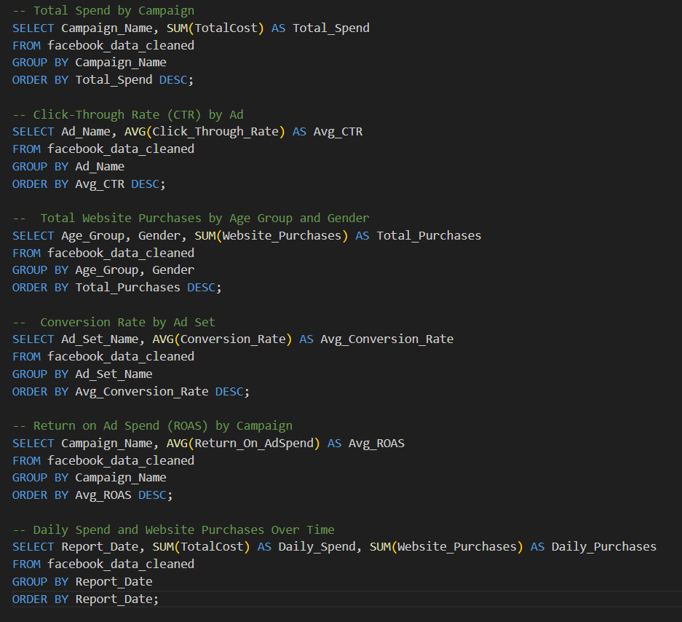
SQL – Key Kpi’s

Slide 14
Facebook KPI Verification using SQL: Ensuring Data Accuracy
Objective: Validate key Facebook marketing performance indicators across SQL, Excel, Tableau, and Power BI for reliable insights and decision-making.
Key KPIs Under Review:
Total Spend by Campaign: Overall budget allocation and cost per campaign.
Click-Through Rate (CTR) by Ad: Engagement and effectiveness of individual ad creatives.
Total Website Purchases by Age Group & Gender: Audience segmentation and purchase behavior.
Conversion Rate by Ad Set: Efficiency of ad sets in driving desired actions.
Return on Ad Spend (ROAS) by Campaign: Profitability of advertising efforts.
Daily Spend & Website Purchases Over Time: Trends and performance over a specific period.
Why Cross-Verify? (Critical Importance)
Data Integrity: Confirm consistent data loading and accuracy.
Calculation Validation: Ensure formulas and logic are applied uniformly.
Early Discrepancy Detection: Identify and resolve data errors promptly.
Build Trust: Instill confidence in KPI values for strategic planning.
Cross-Verification Process:
Extract: Obtain KPI values from SQL queries, Facebook Ads Manager, Excel, Tableau, and Power BI for identical periods/segments.
Compare: Line up results side-by-side to highlight any differences.

Slide 15
Challenge (Problem) | Solution (How to Fix It)
1. Ads Cost Too Much Per Click (CPC) (e.g., Ad 074 is expensive) | Test New Ads: Try different pictures, words, and offers. Refine Who We Target: Show ads to more specific people.
2. Some Campaigns Waste Money (e.g., Campaign 12 is doing nothing) | Stop Bad Ads: Turn off campaigns that aren't working. Rebuild or Replace: If they have potential, make them completely new.
3. Engagement Goes Up & Down (e.g., likes dropped in Dec-Jan) | Find Out Why: See what caused the drops and peaks (e.g., holidays, old ads). Plan Ahead: Schedule new ads often to keep people interested.
4. Likes Don't Grow Much (e.g., high reactions, low page likes) | Ask for Likes Clearly: Make it obvious for people to "Like Page" in ads. Retarget Engaged Users: Show ads asking people to like the page if they already interacted.
5. Hard to See Real Money Gain (Only conversion rate, not sales) | Connect Data: Link ad results to actual sales/revenue data. Calculate ROI: Understand how much money we get back for every dollar spent.

Slide 16
INTRODUCTION TO LINKEDIN POSTS ANALYSIS
The LinkedIN Post Analysis — a comprehensive data visualization project designed to track, analyzes the Posts Performance in Linkedin
In this project, we have used Excel, Tableau, and Power BI to build insightful dashboards that showcase key metrics such as:
Engagement Rate
Post Reactions
Post Views
Post Comments
These dashboards help in making to understand the Roles of Posts in Linkedin by providing a clear view of real-time performance through KPIs, charts, and interactive visuals.

Slide 17
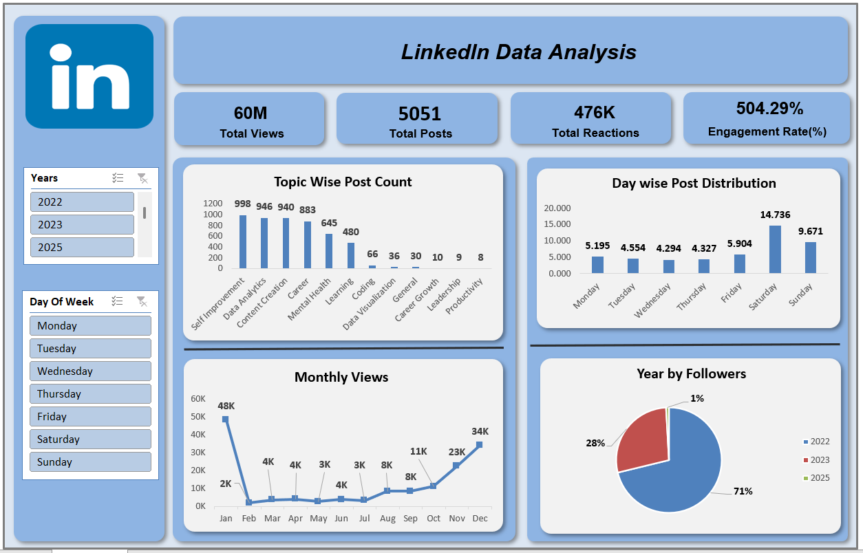

Slide 18
Key Insights: LinkedIn Posts Analysis
Dominant 2022 Views: A significant 82% of total views are attributed to content from 2022, suggesting strong legacy performance.
Year-End View Surge: Views dramatically increase towards the end of the year, peaking in November and December.
Weekend Posting Focus: Most posts occur on Sundays and Saturdays, indicating a weekend-centric content strategy.
Top Content Themes: "Self Improvement" and "Data Analytics" are the most frequently covered topics.
High Engagement Rate Anomaly: The 504.29% Engagement Rate is unusually high and requires immediate validation for accuracy.
Actionable Filters: The dashboard's year and day-of-week filters enable detailed analysis of performance trends.

Slide 19
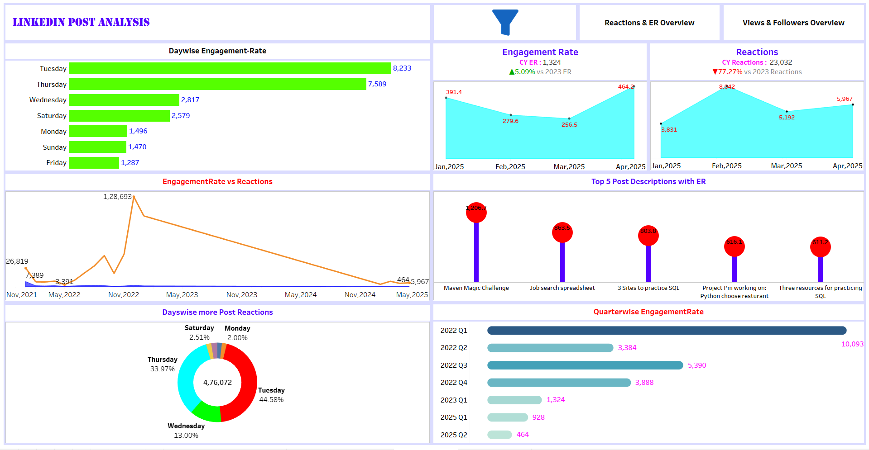

Slide 20
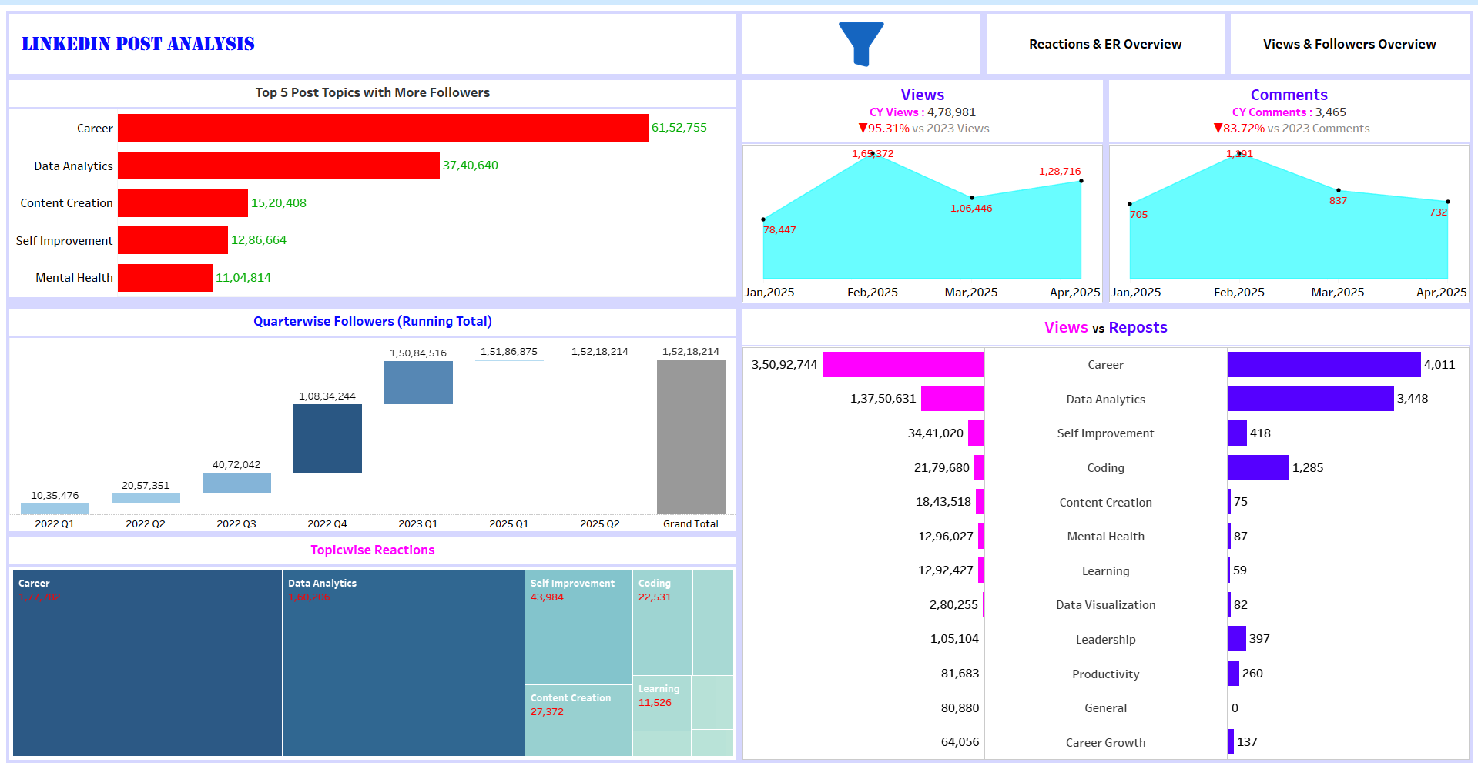

Slide 21
LinkedIn Post Performance – Tableau
Sharp Decline in Reach & Engagement: Views, comments, and engagement rates have dropped drastically in 2025 compared to 2023, despite continued follower growth.
Past Performance Peak: Engagement was exceptionally high in late 2022 (Q3/Nov), indicating a significant change in performance since then.
"Career" & "Data Analytics" Dominate: These topics consistently attract the most followers, reactions, and reposts, showing strong audience resonance.
Tuesday is Best for Engagement: Posts on Tuesdays show the highest engagement rates and generate the most reactions.
Seasonal & Sporadic Peaks: Views surge towards year-end, and there was a notable spike in views/comments in February 2025.
Engagement Rate Anomaly: The reported high engagement rate numbers (e.g., 504%, 10,093) need to be clarified for accurate interpretation.

Slide 22
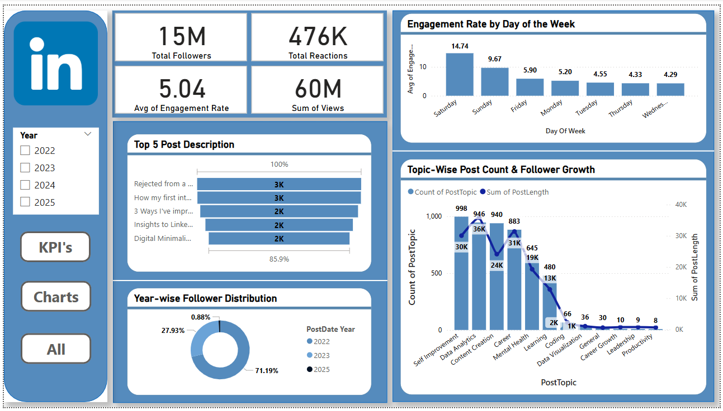

Slide 23
Key Insights: LinkedIn Post Analysis - PowerBI
Follower Growth Stalled: New follower acquisition has nearly stopped in 2024 (0.88%) and 2025 (0%).
Legacy Follower Base: A large majority (71.19%) of followers were acquired in 2022.
Weekend Engagement High: Saturdays and Sundays consistently show the highest engagement rates.
Top Content Themes: "Self Improvement" and "Data Analytics" are the most frequent and impactful content.
Strong Overall Views: The account has accumulated a significant 60 Million total views.
Healthy Engagement Rate: The average engagement rate stands at a solid 5.04%.

Slide 24
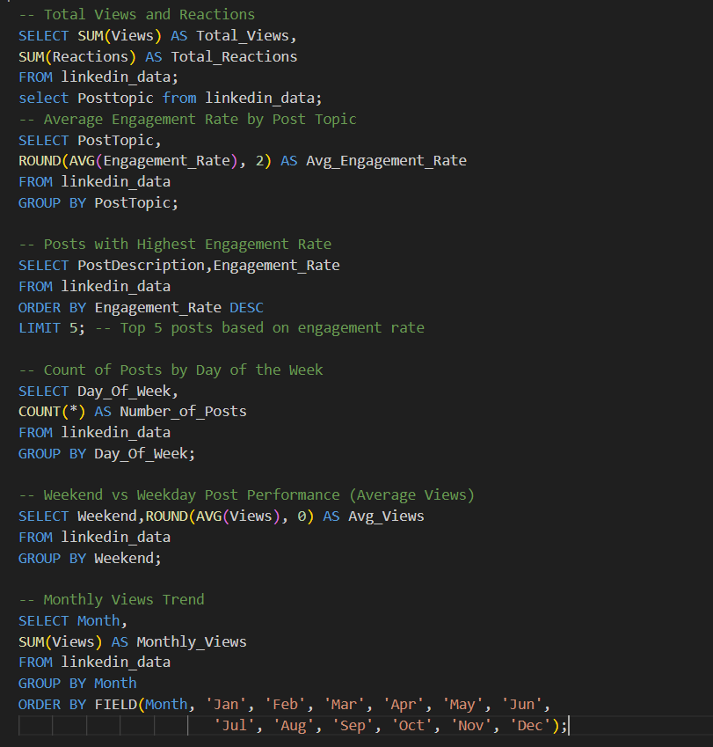

Slide 25
This set of SQL queries is crucial for transforming raw LinkedIn data into actionable insights for your dashboard. Here's information about this process and the KPIs derived:
Core Data Aggregation: These SQL queries are designed to aggregate and summarize your raw linkedin_data into key performance indicators (KPIs).
Dashboard Foundation: The results from these queries serve as the reliable backend data that powers your LinkedIn analysis dashboards (like those seen in Excel, Tableau, or Power BI).
Overall Performance Snapshot: Queries like Total Views and Total Reactions provide a high-level summary of your content's cumulative reach and audience interaction.
Content Strategy Insights: Average Engagement Rate by Post Topic helps identify which specific content themes (e.g., "Data Analytics", "Self Improvement") are most engaging for your audience.
High-Performing Content Identification: The query for Posts with Highest Engagement Rate pinpoints individual successful posts, offering valuable examples for future content creation.
Data Verification Backbone: Using SQL ensures that all KPI calculations are consistent and derived from the same source. This consistency is essential for cross-verifying the values displayed in your dashboards (Excel, Tableau, Power BI) against the database's source of truth.
Ensuring Consistency: This SQL-driven process minimizes discrepancies that might arise from different calculation methods or data filtering in various front-end visualization tools.

Slide 26
Challenge | Solution
1. Views Drop Mid-Year | Plan special content or promotions for low-view months (e.g., Feb, Jun).
2. Low Reactions vs. Many Views | Create more interactive posts; directly ask for reactions.
3. Old Posts Get Most Views (82% from 2022) | Learn from 2022's success; make new content equally strong.
4. Less Posting on Weekdays | Test posting more on weekdays to reach a daily audience.
5. Few Main Content Topics | Explore new, related topics to attract more diverse viewers.

Slide 27
CONCLUSION
Through this project using the Facebook Ads dataset and the LinkedIn Posts dataset, we gained hands-on experience in data analysis and visualization by developing interactive dashboards in Excel, Tableau, and Power BI. By importing and managing the data in SQL, we reinforced our understanding of database concepts and used SQL queries to extract key performance indicators (KPIs), which served as the foundation for the dashboards. This end-to-end process helped us enhance our technical skills across multiple tools, deepen our data interpretation abilities, and learn how to derive meaningful insights from raw data to support data-driven decision-making.

Slide 28
THANK YOU

